Slide 1

The Unofficial Fetal Pig Study Buddy™
Designed & Presented by:
Jeffrey Lupia

Slide 2
The Problem?
Most introductory level Biology students will dissect a fetal pig
Students need to memorize various anatomical parts, but it doesn’t always translate to a exam practical…
Not many resources exist to study
Class average of 62% :`(

Slide 3
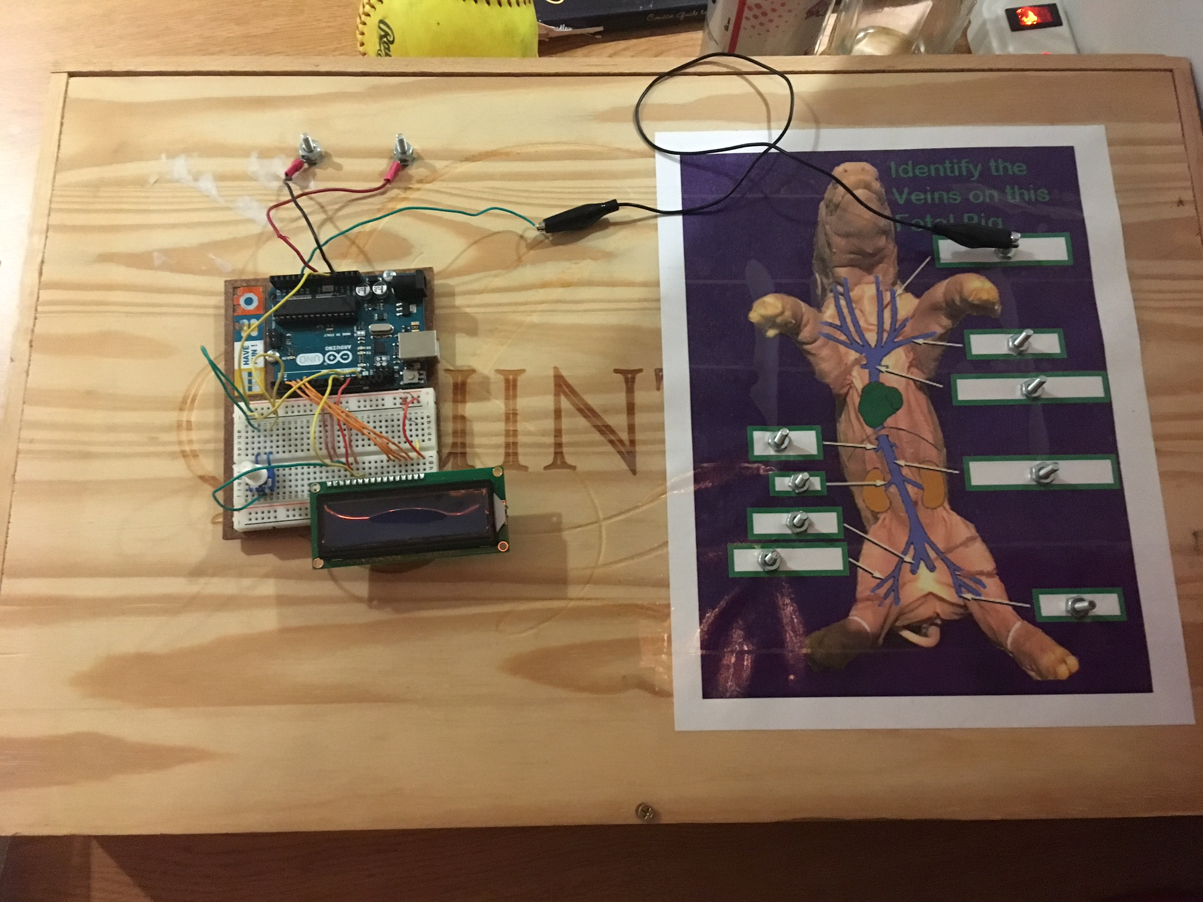
The Solution!!!
The Unofficial Fetal Pig Study Buddy™
Gives users a hands-on approach to studying, allowing for studying in 3D space when not in the lab.
This Method of studying makes memorization easier, and

Slide 4
How Does it work?
Each vein or artery on the fetal pig has a metallic node
When the node is touched, the circuit is completed in the Arduino, and an analog input reads the voltage
The voltage varies between each metallic node, as each connects to different points in a series circuit
Touching different nodes will complete the circuit with different resistances, and so the Arduino will read a different voltage which it then relates to an output on the LCD display

Slide 5
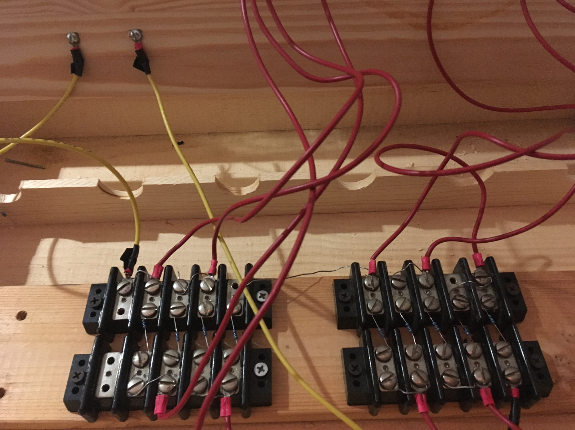
.

Slide 6
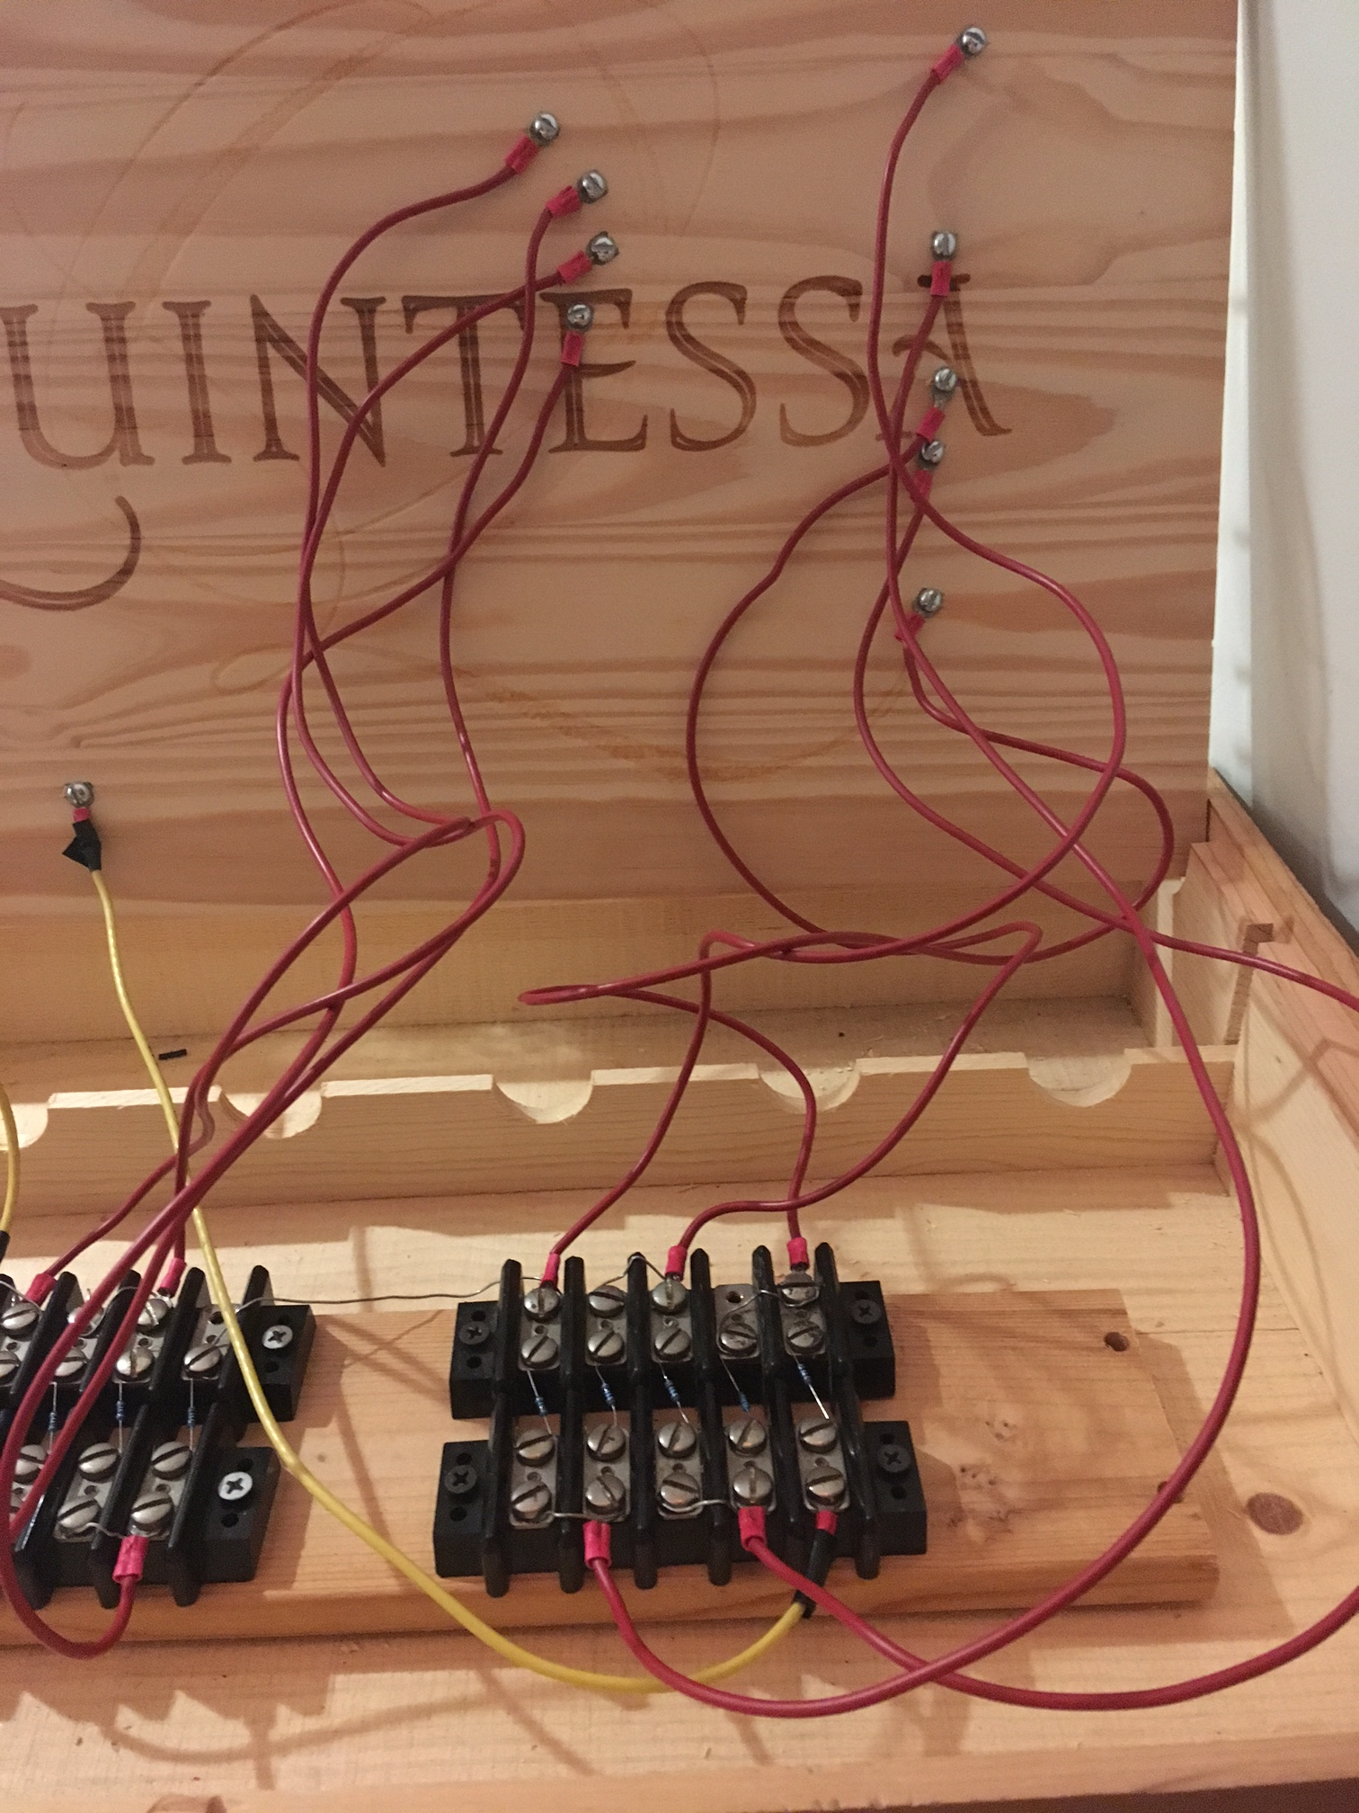

Slide 7
Questions??

